Slide 1


SEO Analysis Report For
https://bigdogginvestments.com/
Date: 30th November 2023
Copyright © WebMobril Technologies
1

Slide 2
Top Observations – https://bigdogginvestments.com/
The majority of the keywords related to https://bigdogginvestments.com/ not rank well on Google. Prospective customers are not able to find your website so we need to address this challenge. Please refer to page 3 for more details.
Your website https://bigdogginvestments.com/ does not fully comply with Google webmaster guidelines, Since the website is not in full compliance your prospective clients will not be able to find your website on the first page of Google. On page 4, page 5, page 6, page 7 and page 8; you will find a technical explanation of what items need to be corrected.
Page Speed Insight
Image Alt and Title Tags
W3C Validation Errors
Google Analytics Set Up
Google Search Console Setup
Robots.txt
Sitemap.xml
Standard URL Format
W3C CSS Validation Errors
Website Load Time
Mobile Friendly
HTTPS SSL Certificate
There is not enough social media engagement, without social media engagement prospective customers are not aware of what your company has to offer. On page 9 we will discuss what steps need to be taken.
The Meta elements in the website are present but may need to optimize as per requirement. This is having a negative impact on your search engine rankings on page 10 and page 11; we will explain the best way to deal with this issue.
Meta Tags
Text HTML Ratio
Header Tags
https://bigdogginvestments.com/ requires more back-links, these back-links need to be from reputable and trusted websites, and on page 12 we are going to explain in detail what steps must be taken.
Your competition has a distinct advantage over you however we can help you regain market share with our brand building strategies highlighted on page 13.
Your business profile is not appearing in some of the most prominent business listings. Please refer to page14; we will explain what steps need to be taken to address this issue.
https://bigdogginvestments.com/ is not converting enough visitors. We can help you increase the number of conversations being generated; please look at page 15 for further clarification.
Email marketing is one of the most effective ways to increase sales. By emailing current and prospective customers, you will maximize your online resources and profits. On page 16 we explain what steps need to be taken to address this challenge.

Slide 3
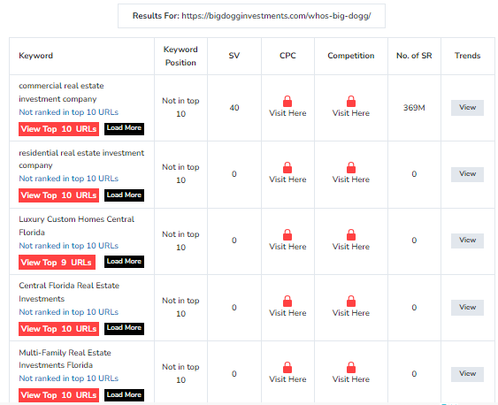
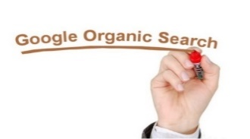
Google Organic Search - https://bigdogginvestments.com/
Most of your business/services related keywords are not visible on Google 1st page in organic search result https://bigdogginvestments.com/ is losing potential business leads, as 80% of the business conversions happen from the top 10 search results.
IMPORTANCE OF ORGANIC SEARCH | VALUE | YOUR SITE SCORE | ACTION
Organic search results are listings on search engine result pages that appear because of their relevance to The search terms. | Not Found | Not Good | Follow Google Webmaster Guidelines. Talk to our Google Certified expert today.
Deliverable: Keyword research and bring agreed keywords to top10 listing in Google, Yahoo, and Bing.
Copyright © WebMobril Technologies
3

Slide 4
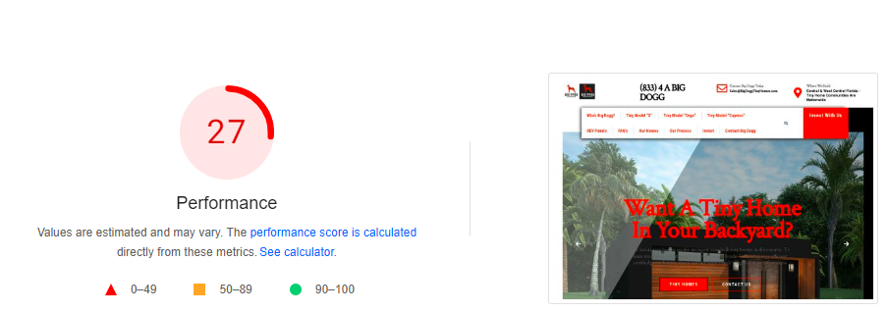
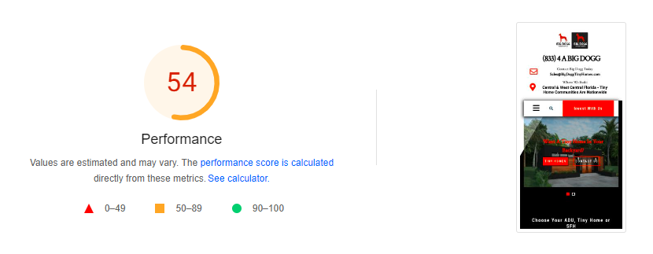
Technical Issues - https://bigdogginvestments.com/
Page Speed Insights: Google is incorporating website speed in search ranking and it is average both for desktop and mobile users. Therefore, we need to work on it to improve speed for users.
Page Speed Insights for Desktop Users – It is low.
Page Speed Insights for Mobile Users - It is average.
Copyright © WebMobril Technologies
4

Slide 5
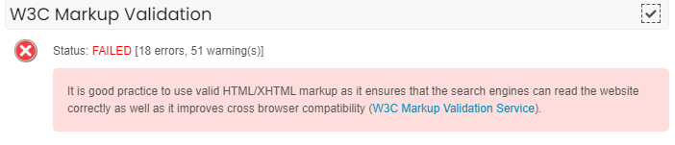
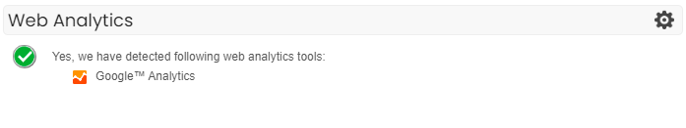
W3C Validation Errors: It is good practice to use valid HTML/XHTML mark-up as it ensures that the search engines can read the website correctly as well as it improves cross browser compatibility. Data Could not be obtained on your website, which is not good for your website health.
Google Analytics Setup: Website hasn’t added in Google Analytics Tool, which is not good for website. It will help to track the visitor activity on website.
Google Search Console Setup: Website is added in Google Search Console tool; which is not good for website. It will help to track the website activity and performance on Google.
Copyright © WebMobril Technologies
5

Slide 6
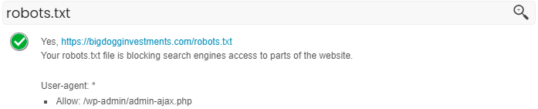
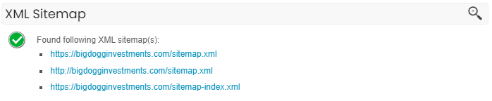
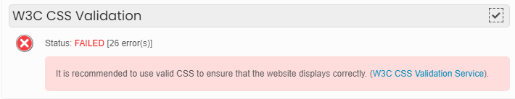
Robots.txt: This file is present in the website, which is good for the website, but we may need to update it as per requirements.
Sitemap.xml: This file is present in the website, which is good for the website, but we may need to update it as per requirements.
W3C CSS Validation Errors: Website has 26 w3c CSS validation errors, which is not good for your website health.

Slide 7
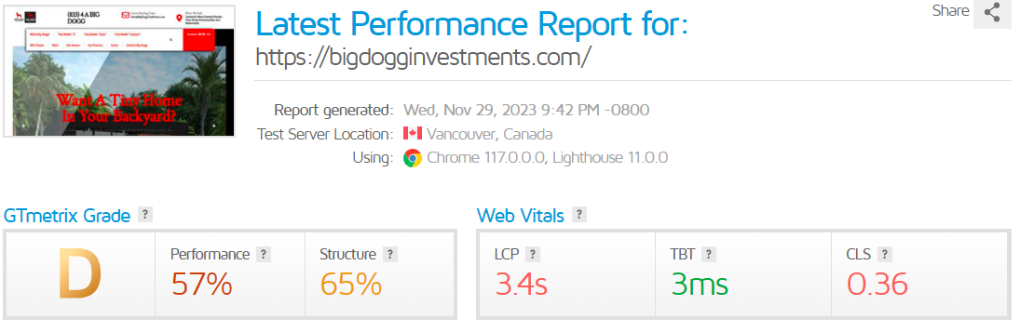
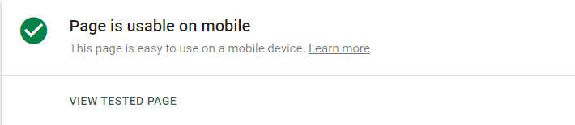
Website Load Time: Website performance grade and website load time is average which is not good for the website health.
Mobile Friendly Test: Website is mobile friendly; which is good.

Slide 8
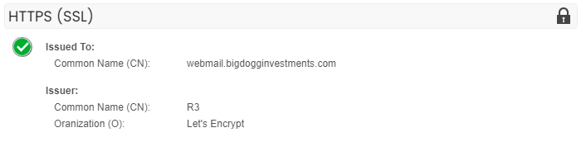

HTTPS (SSL): Website has SSL certificate; which is good for website health, having an up-to-date certificate is an important security practice. Google recommends it and it affects website ranking.
 | VALUE | YOUR SITE SCORE | ACTION
It is a method of analyzing critical aspects of a website from search engine's viewpoint and correcting it, so as to improve its Performance. | Found | Good | Check your site health to find out technical issues. Let our technical team Analyze and brief you on the major issues, and how to fix them.
Deliverable: Fixing all technical issues: Page Speed Insights, Image Alt Tags, W3C Validation Errors, Website Load Time, Mobile Friendly search engine console, Google analytics etc.

Slide 9
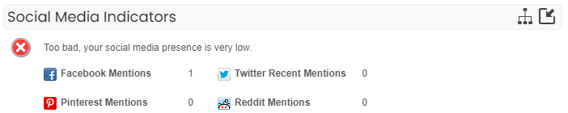
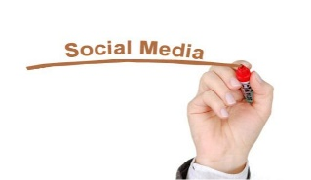
Social Media - https://bigdogginvestments.com/
Social Channels: Your website has no social channel with Your Social Media accounts, which is not for your website’s reach and visibility. In today’s scenario social media channels are highly impactful for visibility of website.
IMPORTANCE OF SOCIAL MEDIA | VALUE | YOUR SITE SCORE | ACTION
Gain traffic or attention n through social media sites by creating, sharing or exchanging information, ideas, and pictures/videos with prospective customers. | Not Found | Not Good | Check and monitor your social media presence. Get in touch with our SMO team to get a detailed analysis about improving your social presence.
Deliverable: Need to create business profile on social media channels like: Facebook, Twitter, LinkedIn, Pinterest, Instagram, Tumblr, Behance, Flicker You Tube, etc. and update all the existing profiles on regular basis.

Slide 10

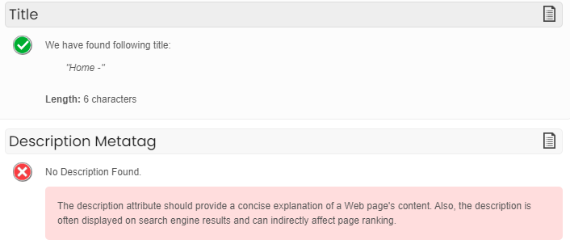
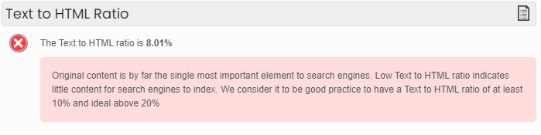
On Page & Content – https://bigdogginvestments.com/
Meta Tags: Website has found Meta Title but not Meta Description Tags is not found. Which is not good for website, so we need to write the meta tags and upload it on website.
Text to HTML Ratio: Website has less web content i.e. 8.01% which is not good for website health. So, we need to add some unique and fresh content to increase the web content ratio of website.

Slide 11
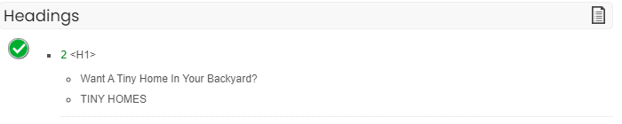

Header Tags: H1 Tag is present in the website; which is not good for website health; while as per recommended by Google at least 1H1 Tag should present on main heading at every webpage of the website and H2 and H3 tags may present more than one time on sub headings
IMPORTANCE OF SOCIAL MEDIA | VALUE | YOUR SITE SCORE | ACTION
Meta tags are for search engines and to some extent Bring user involvement too. These elements give a simple, summarized idea of What a page is about. | Found | Good | Follow Google's guidelines. Let our technical team Analyze and prepare a detail report.

Slide 12
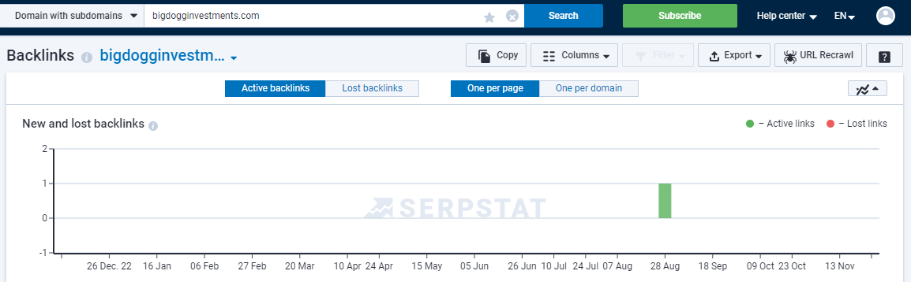
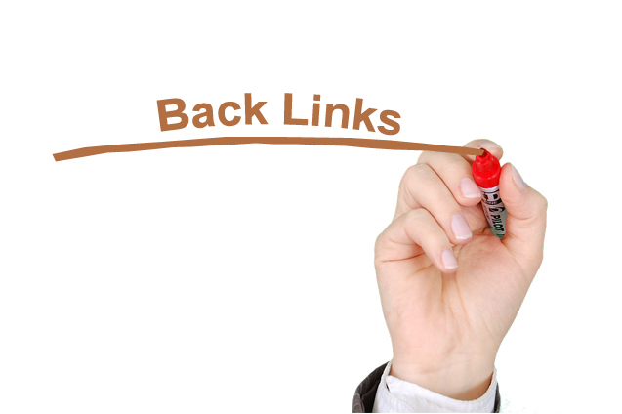
Back Links - https://bigdogginvestments.com/
Therefore, mentioned image indicates https://bigdogginvestments.com/ has some adequate number of unique back-links.
Deliverable: Removal of Toxic back links if any. Building high page rank, domain authority back links .edu, .gov sites or sources like Article, Blogs, Guest Posts, Press Releases, Classifieds, etc.

Slide 13
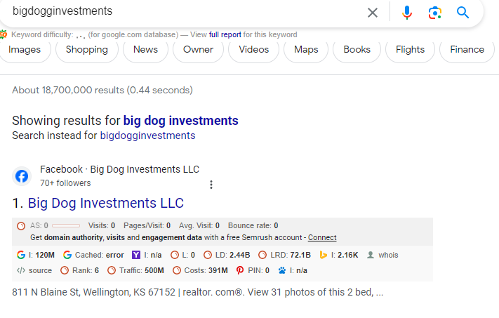
Branding - https://bigdogginvestments.com/
Your website is targeted towards service keywords rather than the brand name. It is not essential to have top 10 search results related to your site when searching for the keyword-phrase “https://bigdogginvestments.com". The website name https://bigdogginvestments.com/ associated with the keyword. Hence, there is a low risk from your competitors. They may promote their website using the same keyword to divert traffic looking for this particular search term, and other related terms associated with this keyword. Branding will strengthen your presence and maintain it. It will ensure that no bad review(s) show up on search results. Competitors will always take advantage to hurt your business reputation. Proper brand building strategies will keep them at bay.
IMPORTANCE OF BRANDING | VALUE | YOUR SITE SCORE | ACTION
It creates a unique name and image for a product/ service in the consumers‘ Mind. | Not Found | Not Good | Know and study your brand value. Consult with our brand in team to know about the brand value of your site.
Deliverable: Crack down on negative listings, Promotion of good reviews, Pull down bad reviews (if any) from web search.

Slide 14
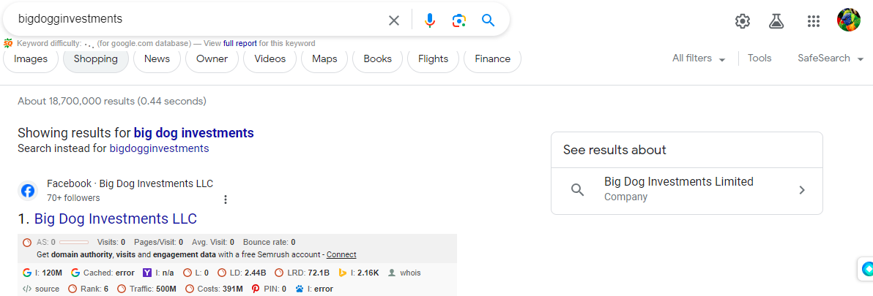

Local Business Listings - https://bigdogginvestments.com/
If a user searches for “https://bigdogginvestments.com” on Google, your website is not showing in Google Local Business on search results. It is not good for your Business and website as your local customers not able to locate your real location.
IMPORTANCE OF BUSINESS LISTING | VALUE | YOUR SITE SCORE | ACTION
Listing your website Locally helps search engines to view your website, and Fetch the content easily. | Not Found | Not Good | Need to do listing in more local Business sites.
Deliverable: Need to submit your business profiles to local business listing sites like: Yellow Pages, Hot Frog, Yahoo! Local, etc.

Slide 15
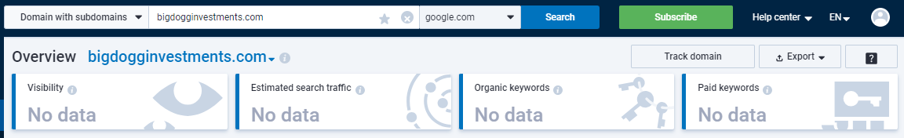
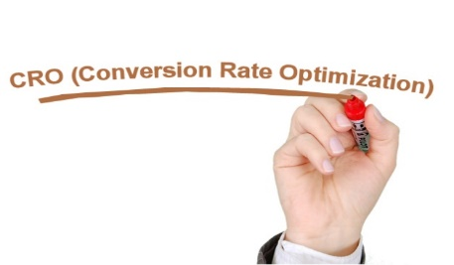
CRO - https://bigdogginvestments.com/
Your site has no visitors. Therefore, conversions cannot be measured exactly. Implementing the latest digital marketing strategies will bring in sizable and steady traffic - best to measure the conversion rate.
IMPORTANCE OF CRO | VALUE | YOUR SITE SCORE | ACTION
It is a method of using analytics and user feedback to improve the performance Of your website. It makes a website perform the best in Every way. | Not Found | Not Good | Build performance-based Landing Pages. Call our team to know how to reduce bounce rate and increase conversion.
Deliverable: Rate of conversion will improve by enhancing usability, reducing bounce rate, optimizing your conversion funnel, speeding up page load and improving your Call to action (CTA).

Slide 16
Email Marketing - https://bigdogginvestments.com/
Your website has not ‘Subscribe' button; it is not good because it is an important tool for successful email marketing. It enhances engagement and reach of a brand/service.
 | VALUE | YOUR SITE SCORE | ACTION
Email marketing maximizes return on investment (ROI), and aims to target core Audience. It enhances engagement and reach of a Brand/service. | Not Found | Not Good | Implement an efficient email Marketing strategy. Talk to our expert for more Information.
Deliverable: Our email marketing campaign will target your audience, create a compelling email, monitor results and boost your sales. We have 5 steps in our process:
1. Discovery: We will have discovery session with you and understand business and discuss about exceptions, goal etc.
2. Create: We will design professional-looking emails and its content.
3. Grow the list: We make it easy to grow your email list and manage contacts also will go social. We will extend your reach and build your business with powerful social media integration.
4. Run: We will run the campaign according to time zone. We will go for Split testing.
5. Track: We will track your success with real-time reporting that makes it easy to plan your next move.

Slide 17
Suggestion:-
Use Live Chat:
For more quick responses and conversions use live chat. People love when brands respond quickly and they get the answer live instead of waiting for the email. This is the best way to convert visitor to a lead.

Slide 18
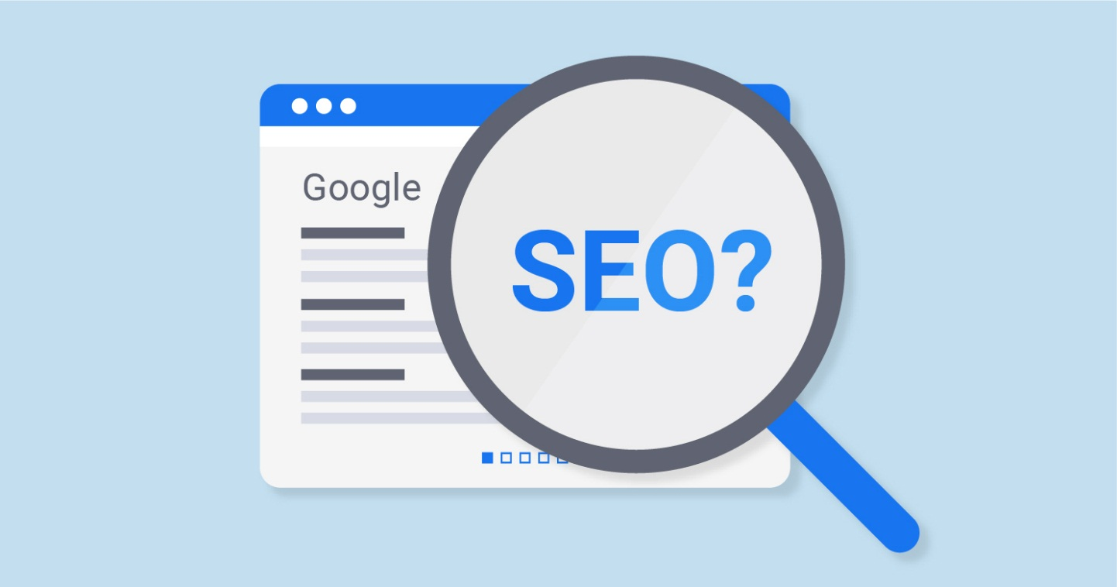
Search Engine Optimization
Search engine optimization (SEO) is the process of affecting the online visibility of a website or a web page in a web search engine's unpaid results—often referred to as "natural", "organic", or "earned" results.

Slide 19
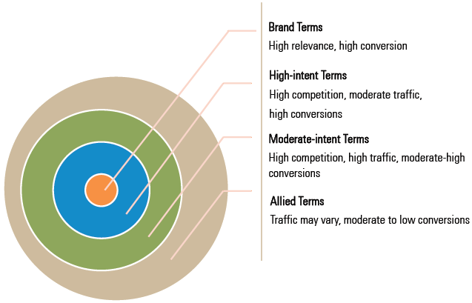
Keyword Targeting
KEYWORD IDENTIFICATION AND SEGMENTATION

Slide 20
On-Page Activities (1st-6th Month)
Activities | Month 1 | Month 2 | Month 3 | Month 4 | Month 5 | Month 6
Meta tags analysis, suggestions and implementation
Web Content analysis, suggestions and enhancement
Monitor GA/GSC on Regularly Bases
Custom 404 Page Implementation
W3C Error Suggestions
Redirection Code ( 301 or 302) Check & Suggestions
New page suggestion and Implementation (If required)
Website Load Time Check & Optimization
Canonical issue check & suggestions
Robots file check and optimize
Check & optimize XML & HTML Sitemap
Header Tag Optimization
Images Optimization
Optimize All Schema Code for the Website
Website navigation analysis
Website Blog Regular Update Suggestion
Check Social Meta Tags & Optimization
Check Interlinking on the Website regular basis
URL optimization suggestion
Header/ Footer implementation suggestion
Broken link analysis and implementation suggestion

Slide 21
On-Page Activities (7th – 12th Month)
Activities | Month 7 | Month 8 | Month 9 | Month 10 | Month 11 | Month 12
Meta tags analysis, suggestions and implementation
Web Content analysis, suggestions and enhancement
Monitor GA/GSC on Regularly Bases
Custom 404 Page Implementation
W3C Error Suggestions
Redirection Code ( 301 or 302) Check & Suggestions
New page suggestion and Implementation (If required)
Website Load Time Check & Optimization
Canonical issue check & suggestions
Robots file check and optimize
Check & optimize XML & HTML Sitemap
Header Tag Optimization
Images Optimization
Optimize All Schema Code for the Website
Website navigation analysis
Website Blog Regular Update Suggestion
Check Social Meta Tags & Optimization
Check Interlinking on the Website regular basis
URL optimization suggestion
Header/ Footer implementation suggestion
Broken link analysis and implementation suggestion

Slide 22
Off-Page Activities (1st – 6th Month)
Activities | Month 1 | Month 2 | Month 3 | Month 4 | Month 5 | Month 6
Blog Creation | 1 | 1 | 1 | 2 | 2 | 2
Blog Submission | 1 | 1 | 1 | 2 | 2 | 2
Blog Promotion | 5 | 5 | 5 | 10 | 10 | 5
Article Creation | 1 | 1 | 1 | 2 | 2 | 2
Article Submission | 1 | 1 | 1 | 2 | 2 | 2
Article Promotion | 5 | 5 | 5 | 5 | 10 | 10
Doc /PDF Creation | 1 |  | 1 | 1 | 1 | 1
Doc /PDF Submission | 1 |  | 1 | 2 | 1 | 1
PPT Creation |  | 0 |  | 0 |  | 0
PPT Submission |  | 0 |  | 0 |  | 0
PPT Promotion |  | 0 |  | 0 |  | 0
Info-graphic Creation | 0 |  | 0 |  | 0
Info-graphic Submission | 0 |  | 0 |  | 0
Info-graphic Promotion | 0 |  | 0 |  | 0 | 0
Classified Creation | 1 | 1 | 1 | 2 | 2 | 2
Classified Submission | 3 | 3 | 4 | 8 | 10 | 10
Image Submission |  | 5 | 5 |  |  | 5
Business Listing | 2 | 1 | 2 |  |  | 3
QA's |  | 1 | 2 | 2 | 3 | 2
Press Release Submission (If required)

Slide 23
Off-Page Activities (7th – 12th Month)
Activities | Month 7 | Month 8 | Month 9 | Month 10 | Month 11 | Month 12
Blog Creation | 2 | 3 | 2 | 3 | 3 | 3
Blog Submission | 2 | 3 | 2 | 3 | 3 | 3
Blog Promotion | 10 | 10 | 15 | 15 | 20 | 15
Article Creation | 2 | 3 | 2 | 3 | 3 | 3
Article Submission | 2 | 3 | 2 | 3 | 3 | 3
Article Promotion | 10 | 10 | 10 | 10 | 15 | 15
Doc /PDF Creation | 1 |  | 1
Doc /PDF Submission | 2 |  | 4 | 4 |  | 4
PPT Creation |  | 1 |  | 1 |  | 1
PPT Submission |  | 3 |  | 2 |  | 3
PPT Promotion |  | 5 |  | 5 |  | 5
Info-graphic Creation | 1 | 1 | 1 | 1 | 1 | 1
Info-graphic Submission | 4 | 2 | 4 | 2 | 6 | 2
Info-graphic Promotion | 10 | 5 | 10 | 5 | 15 | 5
Classified Creation | 2 |  | 3 |  | 2
Classified Submission | 10 |  | 15 |  | 10
Image Submission | 5 | 5 |  | 5 |  | 5
Business Listing |  |  |  |  |  | 2
QA's | 3 | 2 |  | 2 |  | 3
Press Release Submission (If required)

Slide 24
SEO STRATEGY & Approach
STEP 1
STEP 2
STEP 3
STEP 4
STEP 5
Technical Elements
On Page Elements
URL
Revision
Content
Off Page Activation
Identify the technical elements of section of the website
Redrafting the elements with the proper use of keywords in the main elements
Two or more URLs running same content on webpages
Content Optimization & Internal Linking Improvement
Content based focused Off page activities
Better Crawlability of the Section & good user experience
Push ranking on the keywords that have low competition
Remove Duplicity Issue of the website
Better density, keyword based content & anchor text using relevant keywords
Support in ranking of critical keyword

Slide 25
Key Tasks in Campaign Process
Technical Health
Opportunity Analysis
Load Time Optimization
Competitor Analysis
Website Content Analysis
Setting Up Conversion Tracking
Keyword Identification & Mapping
Benchmarking
Finalizing Content Strategy
On Page Optimization
Off Page Content Planning
Monthly Reporting & Analysis

Slide 26
SEO Activities Post Set Up – Monthly Optimization
Campaign Performance Reports
Highlighting campaign status on KPIs
On-page Optimization Report
Activities carried out during the month
Content Marketing
Content Marketing Activities Summary
Keyword Rankings
Organic Traffic
Leads Generated
Activities Completed
Plan of Action
On Page Elements
Content Suggestions
Content syndication
Back Link Creation
Activities on Content marketing platforms
Website Changes
Technical Improvements

Slide 27
Content Avenues
Videos
Youtube.com
Dailymotion.com
Presentations
authorstream.com
slideboom.com
Infographics
magic.piktochart.com
visual.ly
Images
pinterest.com
flickr.com
Social Link Building
Facebook
Twitter
Business Listing
hotfrog.in
grotal.com
FOCUS
Content Avenues

Slide 28
Expected Result
EXPECTATION
1st page Google ranking of keywords
Increase in Website traffic
Increase in return visits
Increase in Non-branded search traffic
Increase popularity in Social networks
Increase in brand reputation
Higher visibility in local listing
Increase in organic, social media, email conversions
Decrease in bounce rate
RESULT
Increase in Sales
Increase in email sign-ups
Increase in inquires
Increase in phone calls
Increase in subscriptions

Slide 29
Commercial:-
MONTHLY SEO PACKAGE QUOTE –
USD 300 per month only for 10 Keywords
USD 500 per month only for 20 Keywords
USD 800 per month only for 30 Keywords
USD 1200 per month only for 50 Keywords
USD 2400 per month only for 100 Keywords
MONTHLY SMO PACKAGE QUOTE -
Social Channel - Any 3 , USD 400 per month
Social Channel - Any 4 , USD 500 per month
Social Channel - Any 6 , USD 600 per month
Under any SEO/SMO Package our web services and solutions are available for a period of THREE and SIX months Contract.

Slide 30
PAYMENT METHOD
By Bank Wire Transfer:
Bank Name: ICICI Bank Ltd
Account No. 088505000648
Branch Address: H-1/34, Sector - 63, Noida – 201301
Account Type: Current
Swift Code: ICICINBBCTS
IFS Code: ICIC0000816
MICR Code: 110229089

Slide 31
Service Agreement page 1 of 2:
WebMobril Technologies
G-18, Sector-63, Noida 201301 UP, India +91-9818013708; e: info@webmobril.com
DIGITAL MARKETING SERVICE AGREEMENT
This agreement is hereby entered on this day 3rd May 2023 by and between: WebMobril Technologies a Digital Marketing Company, with principal office located at G-18, Sector-63, Noida 201301 UP, India hereinafter referred to as "service provider", "we", "us","our" on the First part And “https://bigdogginvestments.com” with address “ USA”; Its web site in the name and style https://bigdogginvestments.com/ here in after referred to as "Client", "you", "him", "his" on he Second Part.
REPRESENTATIONS
WebMobril Technologies agrees to provide the Client with Search Engine Optimization services, which starts on the 3rd May 2023. We are authorized to use the specific keywords and/or phrases for marketing campaign approved by both parties. The scope of service includes promoting website in the search engines like Google, Yahoo and Bing.
SERVICES AND DELIVERABLES
The Service provider is committed to perform for the "Client" the digital marketing services and provide following deliverables based on booked man-hours: Website Analysis Report, Pre SEO Report, Keyword Analysis*, Link Building details, On-page Recommendations, Social Media Activities (SMO), Conversion Rate Optimization (CRO), Brand Management, Business Listings, Content Marketing, Paid Campaigns and Monthly report(s). Mobile APP development, responsive site design, website re-designing, development, landing page creation, mass content production is not included unless agreed.
*The campaign keyword selection is based on the specialization of service provider and client has to approve the keywords suggested by service provider. The number of keywords for campaign is based on the plan. Unless agreed this number is not changed. Landing pages must be created and uploaded to the site to see keyword ranking by both the parties.
TRANSPARENCY OF COMMUNICATIONS
The service provider stands dedicated to special promises, offers, commitments, benefits and/or privileges made/agreed during sales process. For the best interest of both parties, you are advised to produce valid emails/chat transcript before claiming such offers.

Slide 32
Service Agreement page 2 of 2:
TERMINATION POLICIES
If the client decides to end the project for lack of funds, change in focus or for any other reason other than which violates any terms of this agreement, then the client is required to intimate the service provider 10 days prior to his monthly payment date.
ASSIGNMENTS AND SPECIFIC RIGHTS
For the purpose of receiving professional digital marketing services, Client agrees to provide the following: Full access to existing website traffic statistics e.g. Google Analytics, for analysis and tracking purposes. Authorization to use of clients' logos, trademarks, Website images, content etc., for marketing purpose.
ACKNOWLEDGEMENT
Client acknowledges the following with respect to Digital marketing services from WebMobril Technologies: If there is any kind of delay from the client side, the Service provider is responsible to complete the task of the entire month by utilizing additional resources. However, the recurring payment dates must not be disturbed.
IN WITNESS WHEREOF, the "Service Provider" has executed the foregoing with the signature of its duly authorized officer, and the "Client" has executed with the signature of its Founder
Chris Gash, to accept this contract and sign at the prompt; you will be emailed a copy for your records.
WebMobril Technologies | Company Name: https://bigdogginvestments.com
By: Aashi Soni | By: Chris Gash
Designation: Business Development Executive | Designation: Owner
The "Service Provider" | "Customer"
Attn: WebMobril Technologies | Attn: Big Dog Invertment
G-18, Sector-63 | Client Website: https://bigdogginvestments.com/
Noida, UP 201301 | Email: cgashfit@gmail.com
M: 91- 798-764-1863 | Tel: N/A

Slide 33


WebMobril Technologies | +91-9818223170 | info@webmobril.com
Case Study of Our SEO Projects
1.Project
About Us: CMA was established with a mission to inspire positive change through mastery coaching. Our proprietary programs are geared towards success with empirically based models for coaching.
The Target Market is Global. In addition, we are targeting 19 countries separately for this project.
We started managing their Search Engine Optimization and Social Media Optimization since Nov-2016.
Keywords Package: 100 Keywords
Ranking Improvements:
In the 6 months period after implementation of SEO recommendations, site’s keywords rankings increased significantly in different regions.
Keywords | Current | Initial
Google.com.sg
Course in Coaching | 3 | Not in 100
Coaching Training | 4 | Not in 100
Coaching Course | 5 | Not in 100

Slide 34
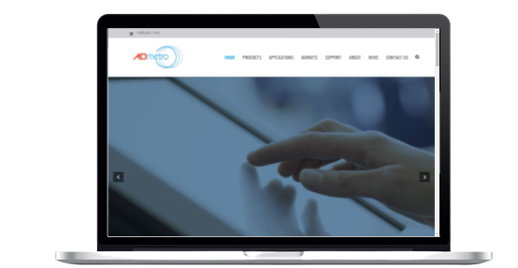
WebMobril Technologies | +91-9818223170 | info@webmobril.com
2. Project
About Us: A D Metro is a leading supplier of touch screen solutions to original equipment manufacturers (OEMs), systems integrators and value added resellers. Our touch screen solutions are designed to address the requirements of commercial, industrial and military applications.
The Target Market is Canada.
We started managing their Search Engine Optimization and Social Media Optimization since March-2021.
Keywords Package: 20 Keywords
Ranking Improvements:
Within 3 months; period after implementation of SEO recommendations, site’s keywords rankings increased significantly.
Keywords | Current | Initial
Google.com
Ultra Resistive Touchscreens | 1 | Not in 100
Projected Capacitive Touch Screen | 1 | Not in 100
PCAP Touch Screens | 1 | Not in 100

Slide 35
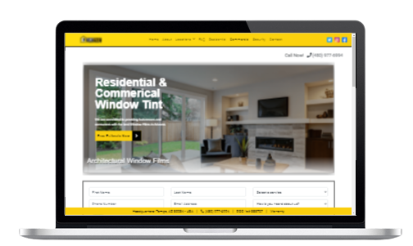
WebMobril Technologies | +91-9818223170 | info@webmobril.com
3. Project
About Us: Tintphx installation process is simple, proficient, and respected by a wide variety of clientele in both residential and commercial businesses. We work with project and property managers, homeowners, contractors, home builders and even glass companies.
The Target Market is USA.
We started managing their Search Engine Optimization since May 2021.
Keywords Package: 20 Keywords
Ranking Improvements:
In the 10 months period after implementation of SEO recommendations, site’s keywords rankings increased significantly.
Keywords | Current | Initial
Google.com
Architectural Window Films in Scottsdale | 9 | Not in 100
Building Tints in Phoenix | 17 | Not in 100
Best House Window Tinting in Phoenix | 19 | Not in 100

Slide 36
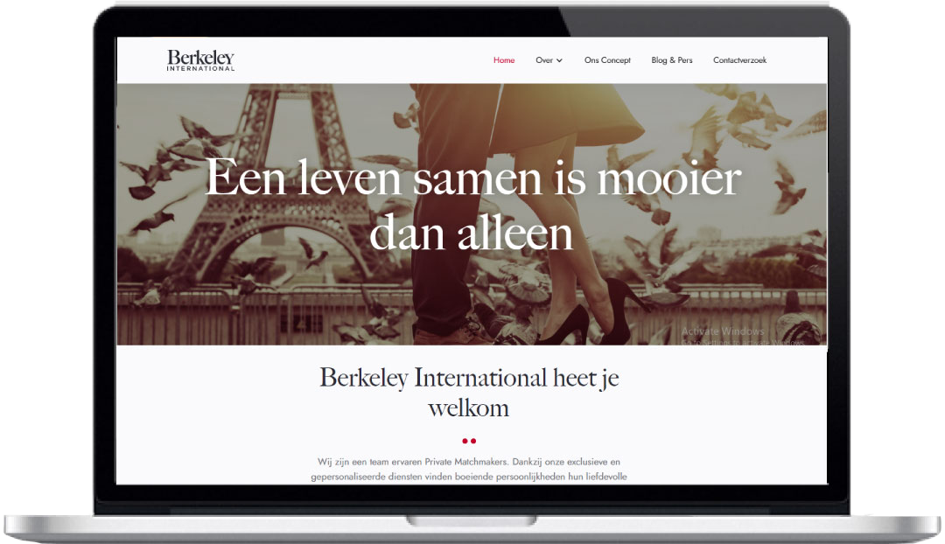
WebMobril Technologies | +91-9818223170 | info@webmobril.com
4. Project
About Us: Day & Knight is a small family business run by Jonathan and Charlie Hope. The business launched in January 2000 in Berkshire and is focused on providing bespoke, quality furniture for your home, along with exceptional service and craftsmanship.
The Target Market is Netherland & France.
We started managing their Search Engine Optimization since Mar-2021.
Keywords Package: 20 Keywords
Ranking Improvements:
In the 3 months period after implementation of SEO recommendations, site’s keywords rankings increased significantly
Keywords | Current | Initial
Agence de Matchmaking Internationale | 1 | Not in 100
Luxe Matchmaking Diensten | 1 | Not in 100
Furniture Design And Build Windsor | 1 | Not in 100

Slide 37
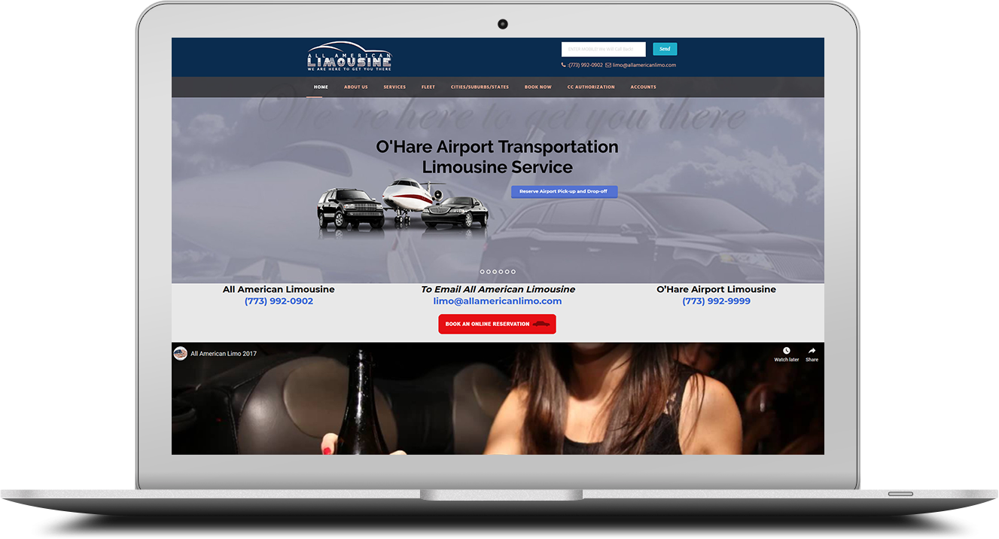
5. Project
About Us: All American Limo are Chicago’s Premiere Limousine, Coach, Chauffeur, and Airport Shuttle Company. Our commitment is your guarantee to dependable, safe, and affordable transportation everywhere in Chicago and Chicagoland Suburbs.
The Target Market is Global.
We started managing their Search Engine Optimization and Social Media Optimization sinceSep-2018.
Keywords Package: 20Keywords
Ranking Improvements:
In the 7 months period after implementation of SEO recommendations, site’s keywords rankings increased significantly in different regions.
Keywords | Current | Initial
Google.com
Transportation Service to O'Hare | 1 | Not in 100
O'Hare Transportation Service | 1 | Not in 100
O'Hare Transportation Service to Chicago | 1 | Not in 100

Slide 38
Customers like WebMobril
Successful Digital Marketing services since 2014
Since its inception in 2014, WebMobril Technologies has become a pioneer in the Web Design and Digital Marketing industry. The company started its Internet marketing venture in 2014, and has become one of the most successful Internets marketing service provider in the world.
Easy payment option with no lock-in period
WebMobril Technologies offers the most cost-effective service in the industry. The company maintains easy and transparent payment method with no lock-in period.
Boost to ROI, online visibility and sales
Our services have helped make sites more authoritative. It has achieved much higher ranking in Google searches for competitive keywords. The strategies have boosted visibility and overall sales.
Specializes in all aspects of Digital marketing services
WebMobril Technologies is one of the most successful and creative Digital Marketers - offering a comprehensive range of strategic Digital Marketing services to clients.
80+ Digital marketing specialists
Our dedicated workforce is ready to serve you at your own convenient time zone. Our services are available 24x7.
95% Clients retention rate
Our effective and result-oriented services have helped thousands of clients to get the best out of their business. Many of the clients are using our services for last 3 years.
Google and BBB Certified
We are accredited by BBB and Google. Our credibility is constantly recognized and rewarded by various quality assessment boards and groups.
Price that fits your budget
We offer services to small, medium and large scale firms. Service packages are highly affordable, and nothing that makes you breaks your bank. You get the flexibility to customize our package to fit your business and budget.
800 + Clientele
Majority of our clientele is from US, followed by UK, Australia, China, and other countries in the world. More customers are pouring in to avail our advanced Digital Marketing services.

Slide 39
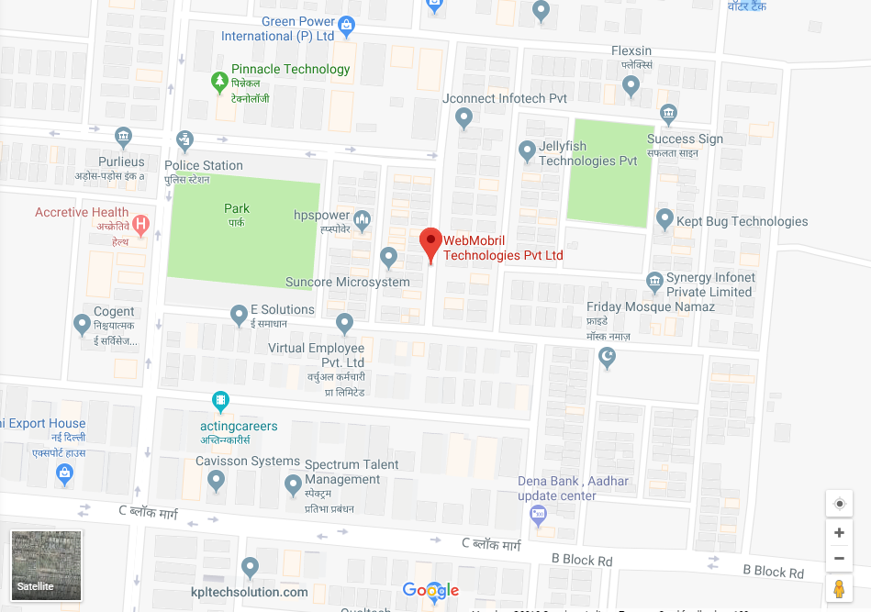





Thank You
Full Service Digital Marketing Agency
For more information about this report and to discuss further, please contact
Address: G-18, Sector-63
Noida (Delhi-NCR)
Pin: 201301, India
Email: info@webmobril.com
IND: +91- 9818223170
USA: +1 646-491-6152
Phone: +91-120- 4147035

